Slide 1
Problem Identification
BMR is considering adding a chairlift.
BMR needs to cover the additional costs.
BMR needs to find the best solution to covering costs.

Slide 2
Recommendation & Key Findings
I would recommend BMR to keep their ticket price lower than the predicted price by my model, as they currently have the most expensive ticket price in the state of Montana, and could be hesitant to raise the price even more. Big Mountain Resort modelled price is $95.88, actual price is $81.00. Even with the expected mean absolute error of $10.36, this suggests there is room for an increase. However, including a fast chairlift that increases BMR’s vertical drop is more valuable than a quad that increases skiable area when determining increased ticket prices. By adding Big Mountain is adding a run, increasing the vertical drop by 150 feet, and installing an additional chair lift. This scenario increases support for ticket price by $1.61
Over the season, this could be expected to amount to $2815217. In addition, BMR should assess their customer base.

Slide 3
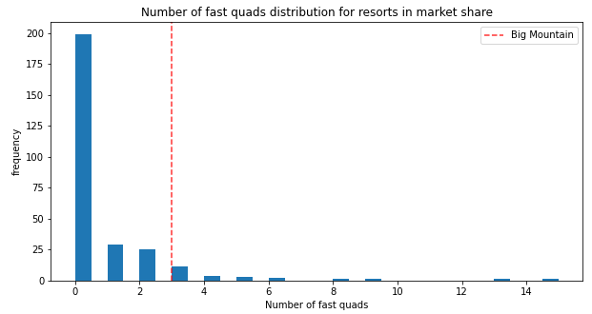
Most resorts have no fast quads. Big Mountain has 3, which puts it high up that league table. There are some values much higher, but they are rare.

Slide 4
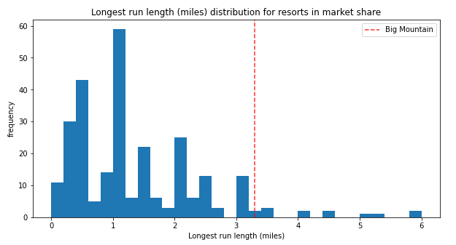
Big Mountain has one of the longest runs. Although it is just over half the length of the longest, the longer ones are rare.

Slide 5
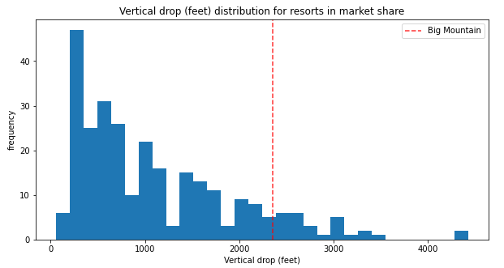
Big Mountain is doing well for vertical drop, but there are still quite a few resorts with a greater drop. The new chairlift will add to the vertical drop.

Slide 6
In conclusion
Big Mountain adding a run, increasing the vertical drop by 150 feet, and installing an additional chair lift increases support for ticket price by $1.61 Over the season, this could be expected to amount to $2815217. This would cover the additional costs of the chairlift and increase the revenue of BMR.

